Slide 1
Tagore’s Approached to Community Development through Social Entrepreneurship- a case study
Prof. Prasanta Kumar Ghosh
Department of Social Work
Visva-Bharati University
Email: prasanta.ghosh@visva-bharati.ac.in

Slide 2
The Culture of Business in India
The social and cultural tradition of India has been rich
Business was confined to specific castes
All products were made locally and manually
Artisans along with their family members were engaged in business with skills inherited from ancestor
Industrial revolution during the British Rule changed the age old business scenario
Indigenous products was axed by factory product

Slide 3
Tagore and Gandhi on Social Entrepreneurship
Great Social Philosophers like Gandhi and Tagore advocated for social entrepreneurship a century ago
When it is not possible to compete individually can be done collectively
The concept of Trusteeship promoted by Gandhi is an unique social entrepreneurship programme
The concept of Cooperative written and applied by Tagore at the turn of the 20th Century was highly valued because the movement enabled people to avoid money lenders but meet their economic needs

Slide 4
The era of industrialization
The industrial development in India begun from 1850s
Migration of people from rural to urban areas also begun in search of employment
The cottage industries in India were adversely affected
People started preferring mill products than that of hand made products as mill products were cheaper
A few entrepreneurs from this country took the risk of business challenging the British companies
The process of indigenous business made the beginning in the country

Slide 5
Tagore in his article ‘the Problem of Education. wrote
“Schools in our country, far from integrated to society, are imposed on it from outside. The courses they teach are dull and dry, painful to learn and useless when learnt. There is nothing in common between the lessions of the pupils cram up from ten to four ‘O’ clock and the country where they live; no agreement but only disagreements between what they learn at school and what their parents and relatives talk about at home. The schools are little better than factories for turning out robots”. Rabindranath Tagore

Slide 6
Incubation Process
Pre Incubation
Research Support, Training, Business Planning
Early Stage
Classic Incubation
Accommodation, Funding Access, Network, Support
Advice, Marketing, Technical, Legal, Accounting
Graduation
Marketing Support

Slide 7
Models of social venture Incubation
There are few models of incubation that have emerged
to support early–stage social ventures:
1. Co–working spaces – offering work space and opportunities for founders to access co–founders, networks and, increasingly, training.
2. Social venture academies – offer training for social venture founders and access tomentoring.
3. Impact accelerators – offer finance, training, access to networks and usually office space.
4. Social venture prizes and competitions – offer finance, profile, mentoring and

Slide 8
Customer hunters – need help with access to potential customers by market survey.
Model fixers – companies with revenues that have found limits in the scale of their business
model.
Scale up – need marketing support as well as recruitment and other services associated with
rapid growth.

Slide 9
Most commonly provided services for incubation are:
Talent spotting and selection.
Mentoring.
Focus on impact.
Access to networks.
Co–location.
Finance.
Marketing

Slide 10
Feasibility study to assess incubator
It is an important and necessary step to design the business incubator and assess whether an incubation be feasible or not.
Topics
Market demands (need analysis)
Stakeholder-Community support
Facilities and Services
Infrastructure
Financial feasibility (Return On Investment)

Slide 11
What are social ventures?
Throughout this report we use the phrase ‘social venture’ to denote an organisation that is trying to achieve a social or environmental impact through business principles. In our experience, social ventures that are aiming to achieve large scale, rapid growth need a different sort of support from those that aim to stay smaller or grow slowly.
This is because companies limited by shares can issue equity, and the finance requirements of high–growth organisations are best suited to equity investing – equity investment provides ‘patient’ capital that entrepreneurs can use to build their business without being burdened by repayments in the short term.

Slide 12
Increasing Revenue Generation through Incubation Process
The Sustainability of Incubator Operations needs
Imaginative ways of raising income
Political stability & favourable business policy
Macro-economic policy structure and regulatory framework that encourage entrepreneurship.
Market potentiality (Internal & External)
Quality and branding

Slide 13
There are different types of Models
Physical goods
Digital products
Service sold per unit
Service sold fixed price
License
Auctions
Advertisements

Slide 14
Rental
Brokerage
Platform/marketplace
Affiliate marketing
Subscription
Usage fees
Franchise

Slide 15
How to develop a revenue model?
Identify target customer
Determine value proposition
Evaluate revenue model options
Select revenue model
Adapt and adjust
You will develop a revenue model.

Slide 16
The incubators’ view: SOCIAL VENTURE INCUBATION STORIES
Jardin de Innovation – Smart Impact Programme
Founded: 2013, Location: Mexico City
Type of programme: Impact accelerator
www.sjardindeinnovacion.org
After working in Europe for several years, Oscar Velazquez returned home to Mexico determined to help get the social entrepreneurial ecosystem going.

Slide 17
Case of Amar Kutir Sociey for Rural Development–a Social Entrepreneurship
While Tagore was intervening with rural communities with self reliant rural organization for rural development Gandhiji appealing the countrymen to wear the clothes made in India. An entrepreneur and one of the freedom fighters along with his associates founded Amar Kutir –(My cottage) by organizing rural inhabitants for training & producing clothes following Tagore's, philosophy of rural reconstruction.
The founder of Amar Kutir used to train the rural artisans and youths for holistic development

Slide 18
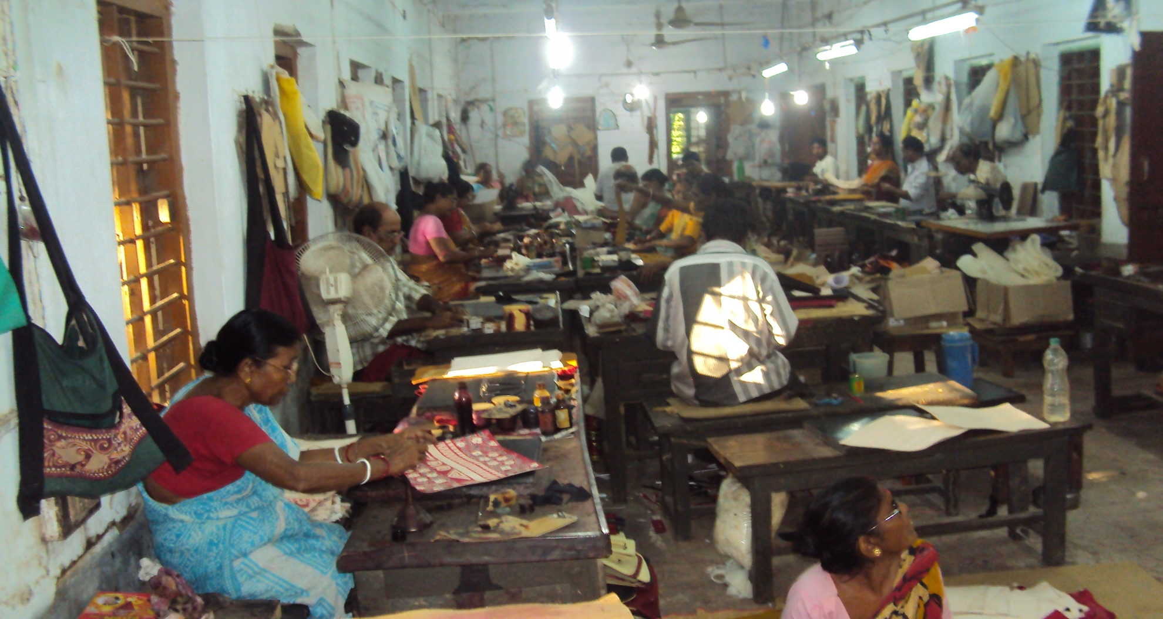
Old Workshop at Amar Kutir

Slide 19
It suffered losses and consequent closure three times between 1936 and 1975
From 1978 when it was registered under Society’s Act and as SSI unit of the district of Birbhum West Bengal,India
It suffered a loss again till 1988 enhancing its liability to suppliers and the employees
In 1989 the committees and executives were changed and was asked to take all measures to improve the condition of the business
By nest two years the situation improved by re-organising the craftsperson through training and improving design of the products & marketing

Slide 20
Globalization from 1991 made it further difficult to improve the business
Strategies to meet the demands of the market applied by reorganizing the production process with few new imported machinery and training the Artisans
Special marketing drives in the metros of India and contacting the vendors for regular sales
Participation in Indian and Expo Meets to contact buyers
Improvement in the quality of all products & add value
Improving the factory out lets to promote local sales
Publicity to attract the visitors and local customers

Slide 21
The Business
In 1988 the total volume of business was 12 lakhs PA with about 50 people engaged those days
Now with 90 artisans the volume of business is more then 5 crore
Number of artisans trained (mostly women) during the last 25 years has crossed 1000 mark and most of them produce at home for sales in the society’s show room
More than 100 rural entrepreneurs are involved in the business of the organisation and many of them directly market the product to the visitors and vendor

Slide 22
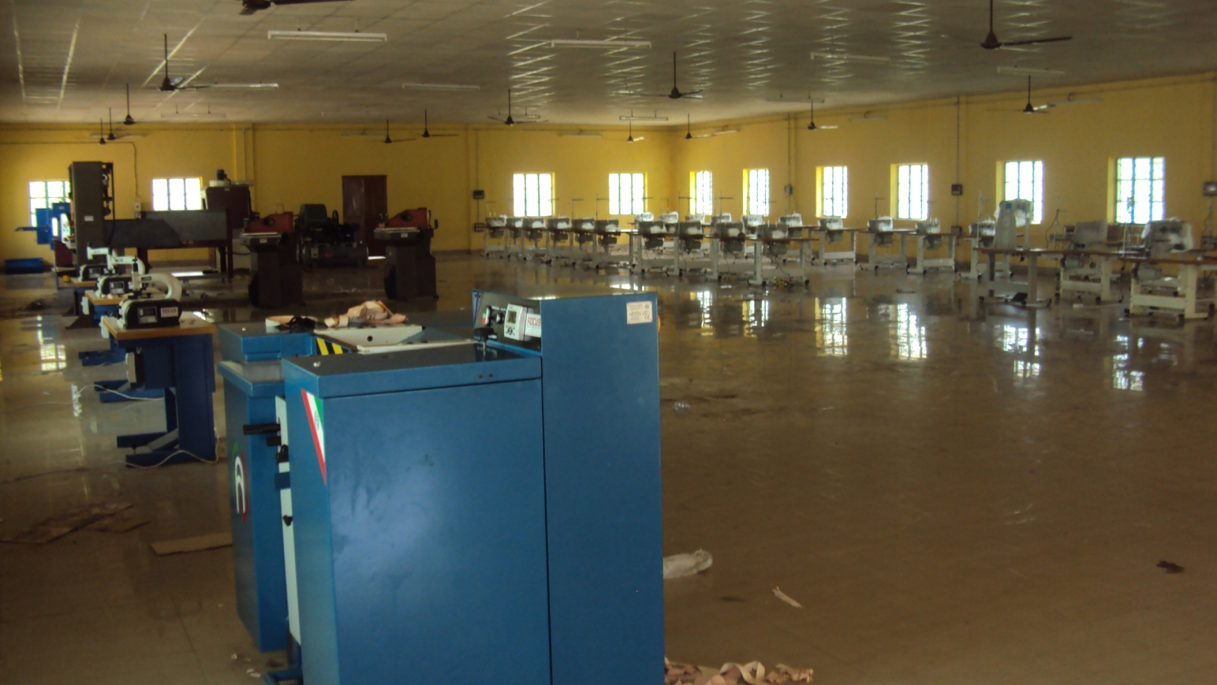
New Workshop of the Society

Slide 23
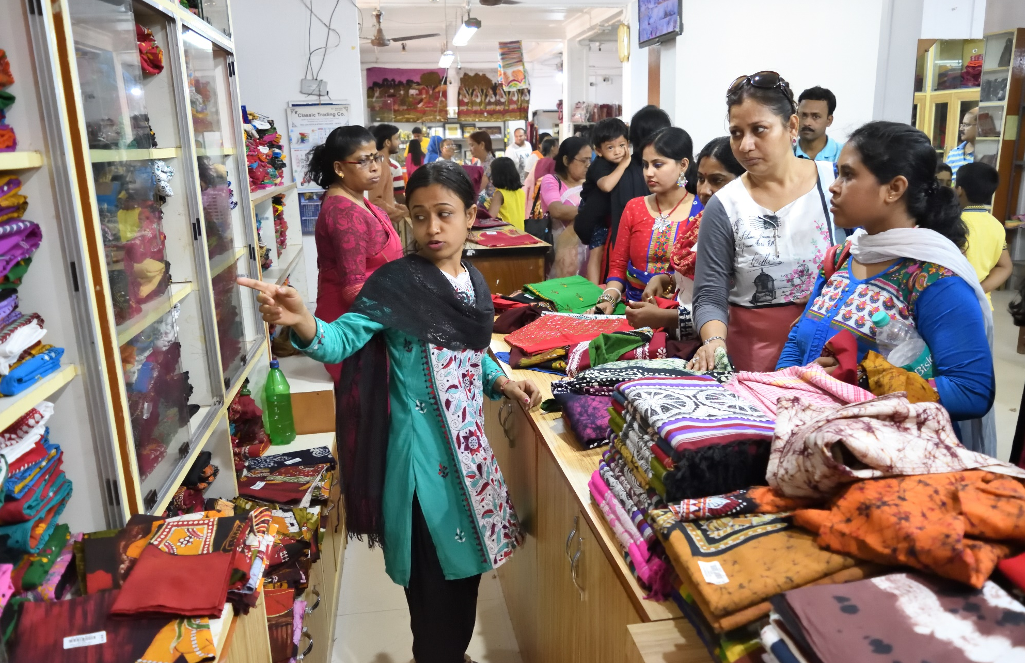

Slide 24
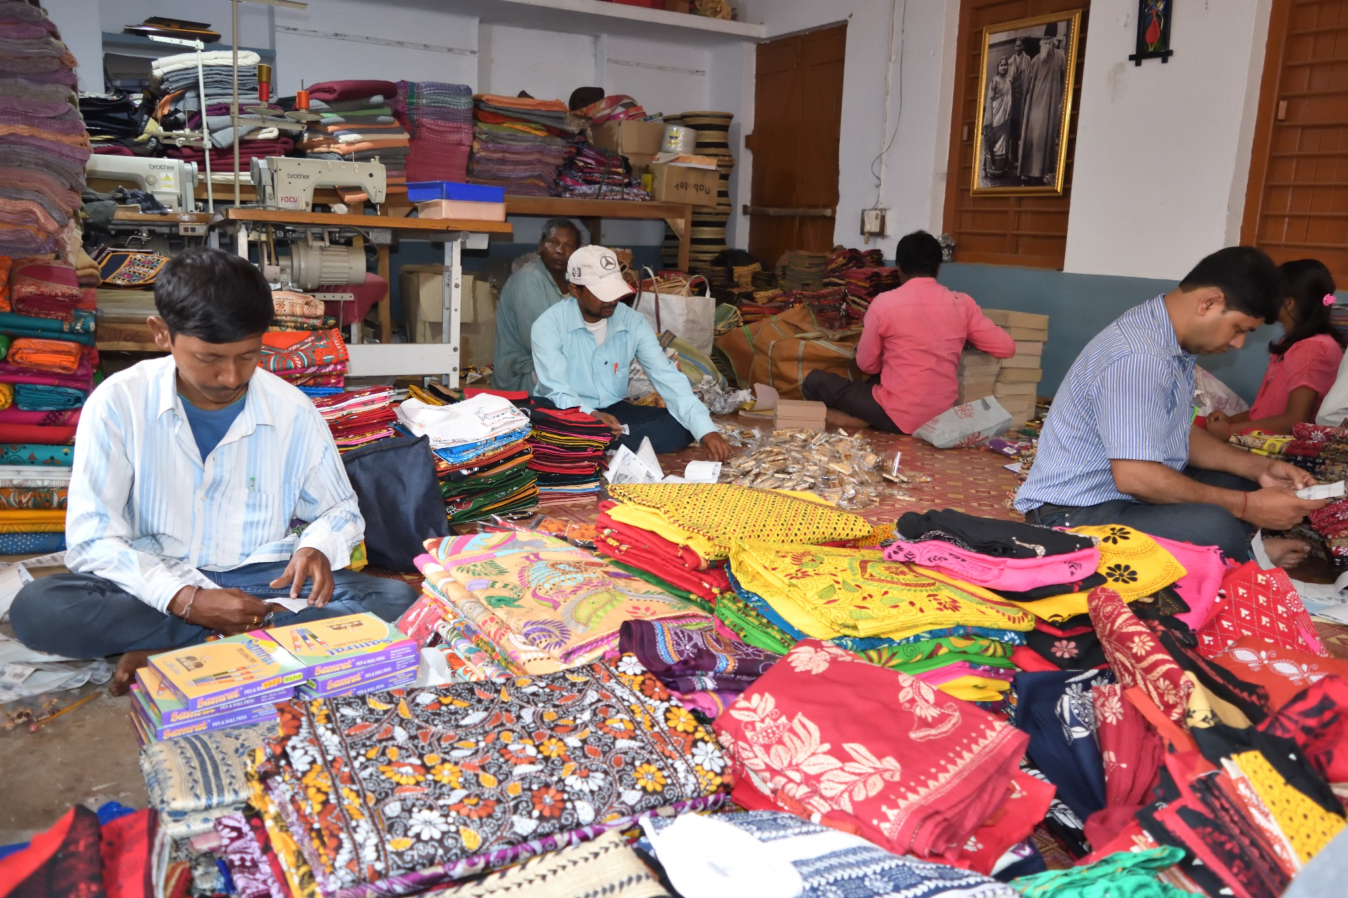

Slide 25
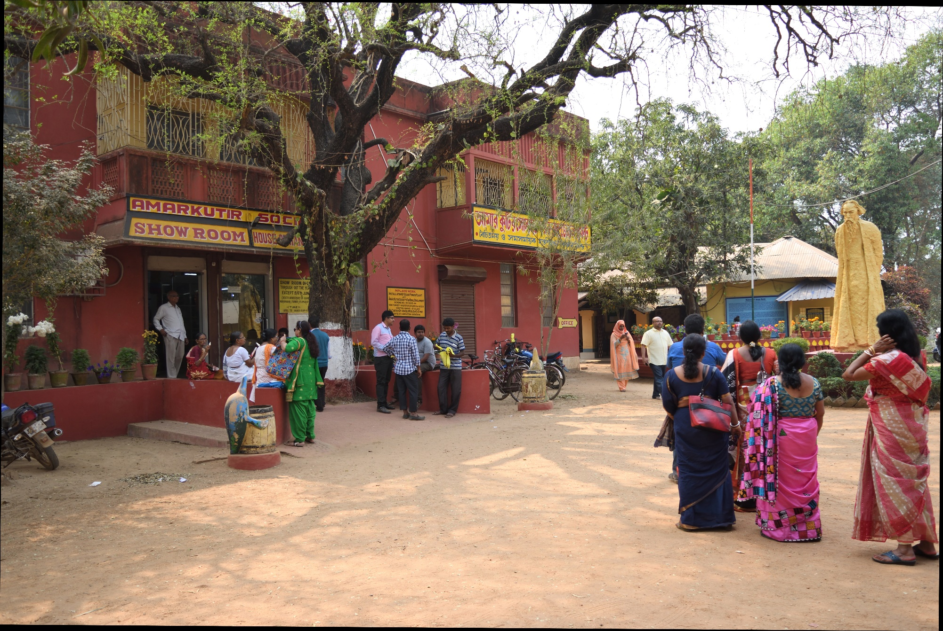

Slide 26
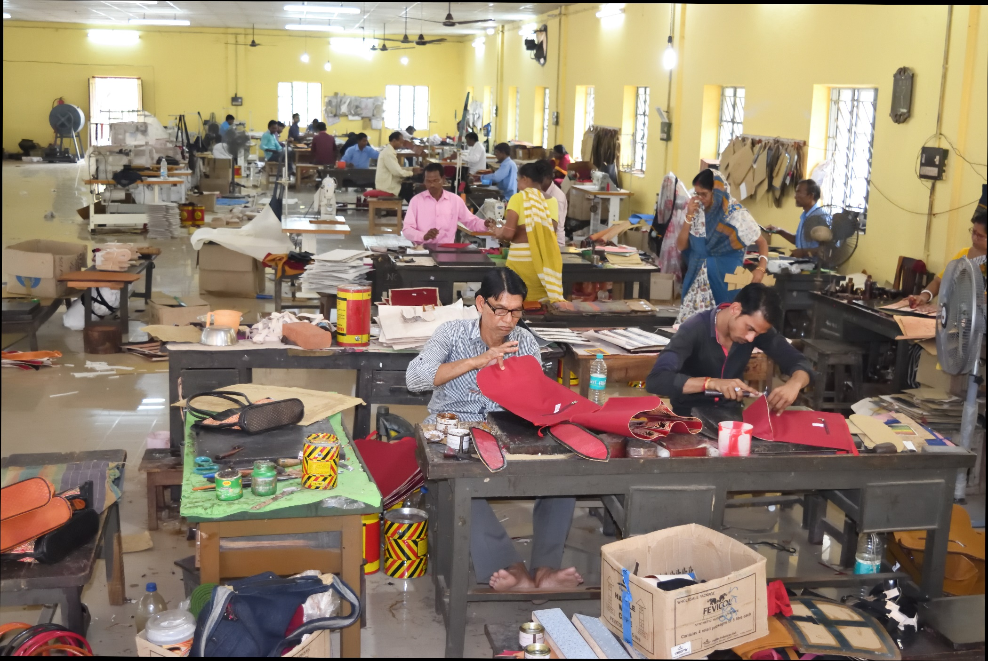

Slide 27


Slide 28
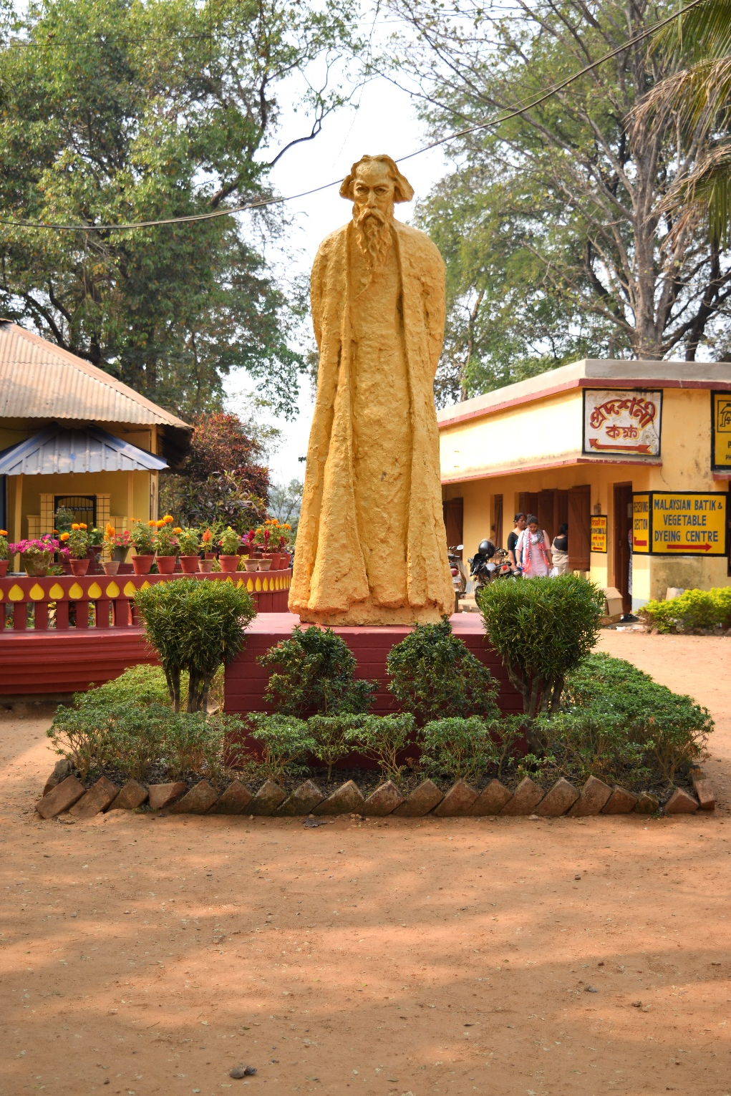

Slide 29
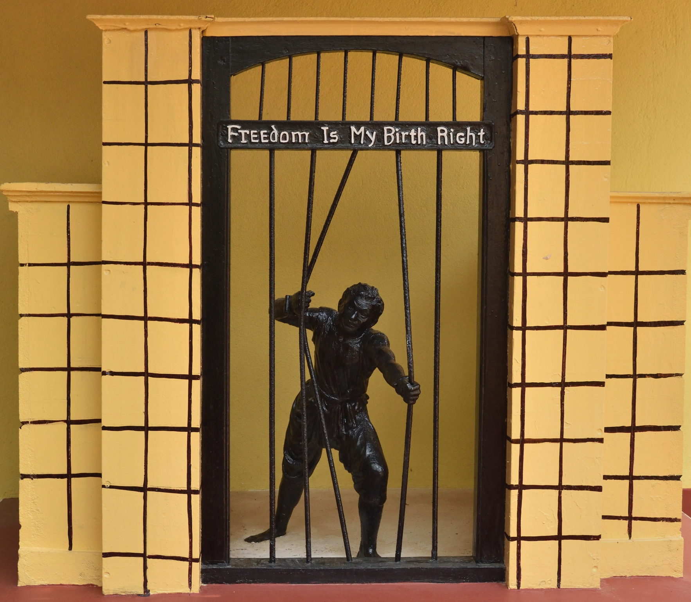

Slide 30
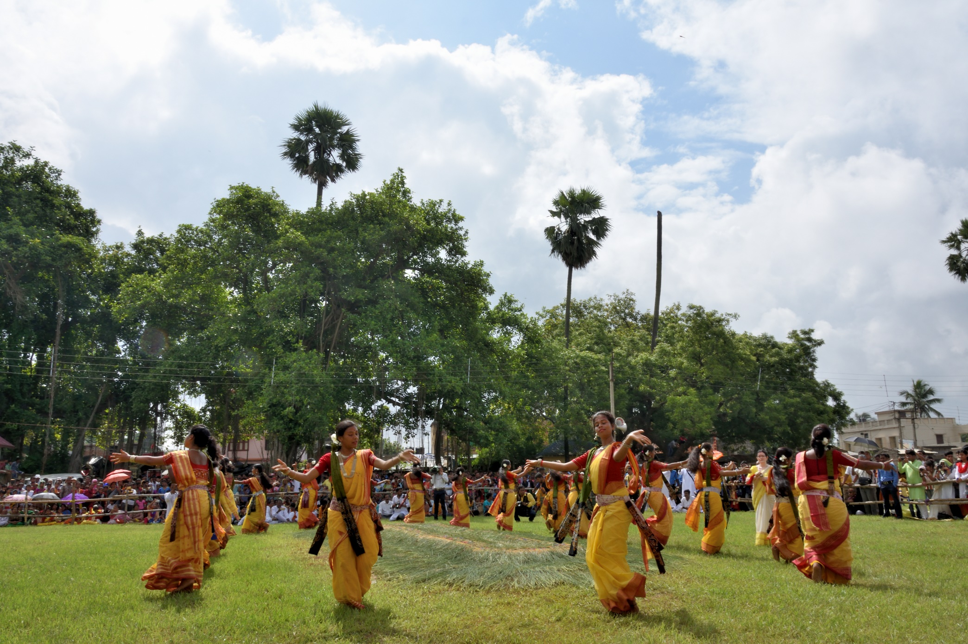

Slide 31
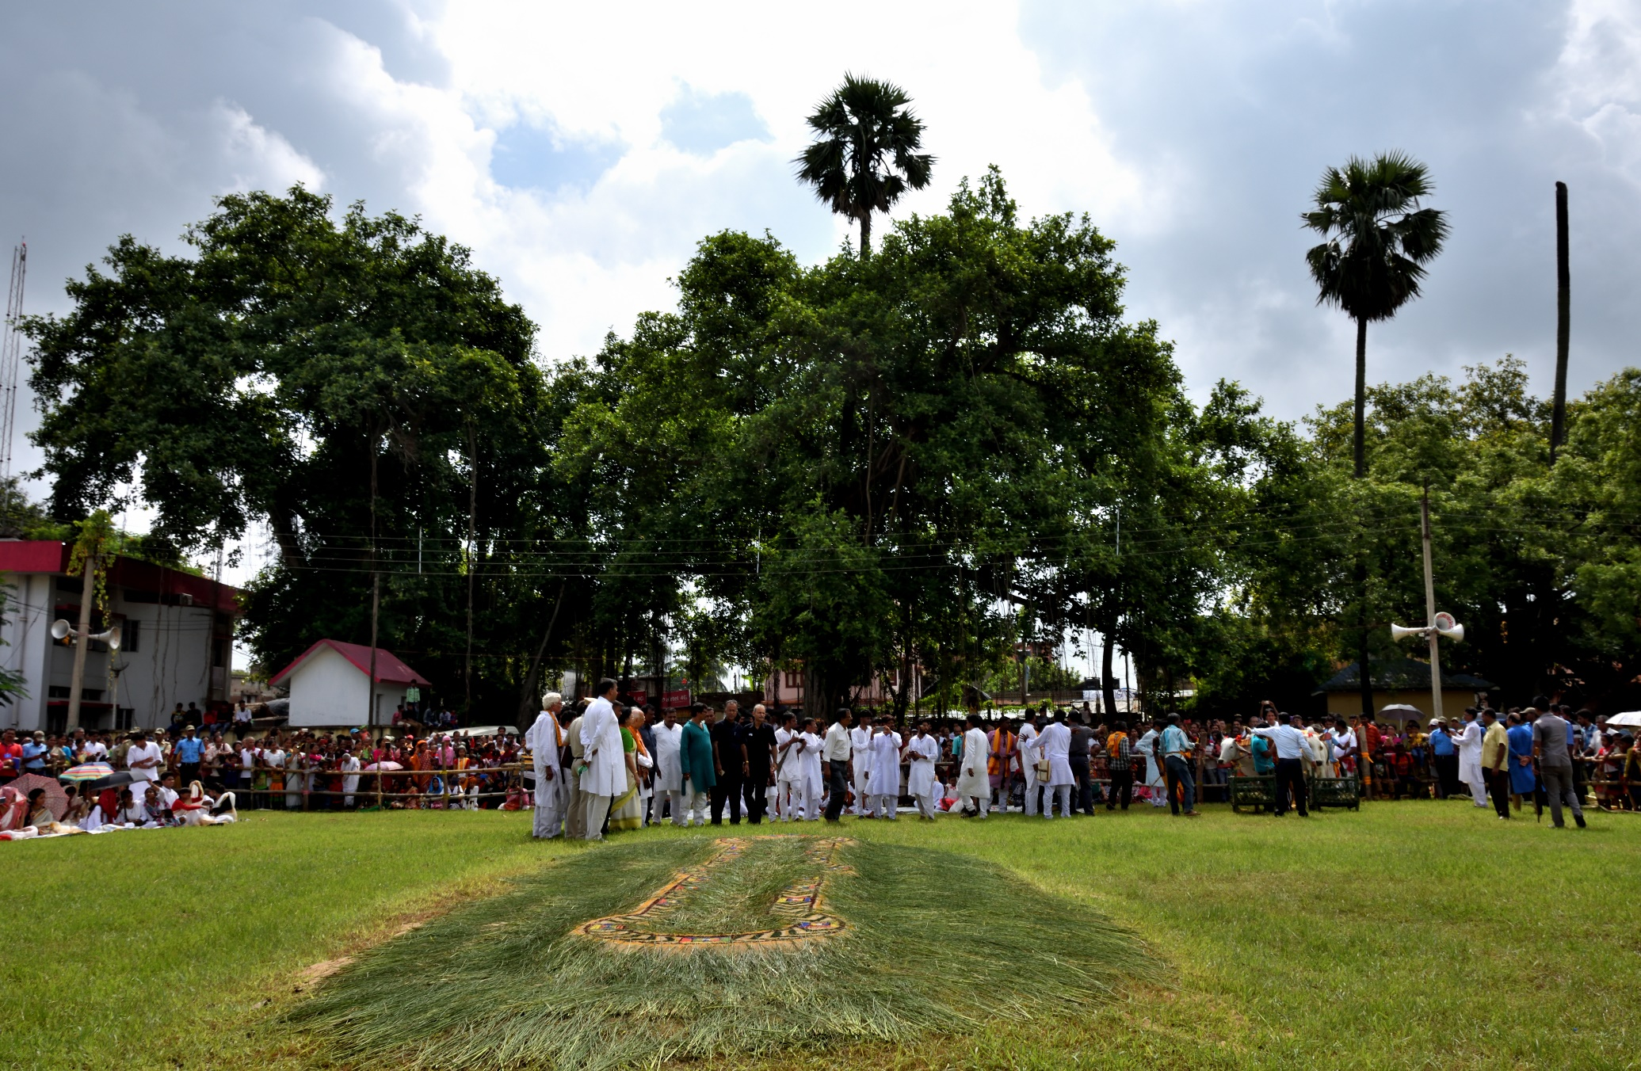

Slide 32
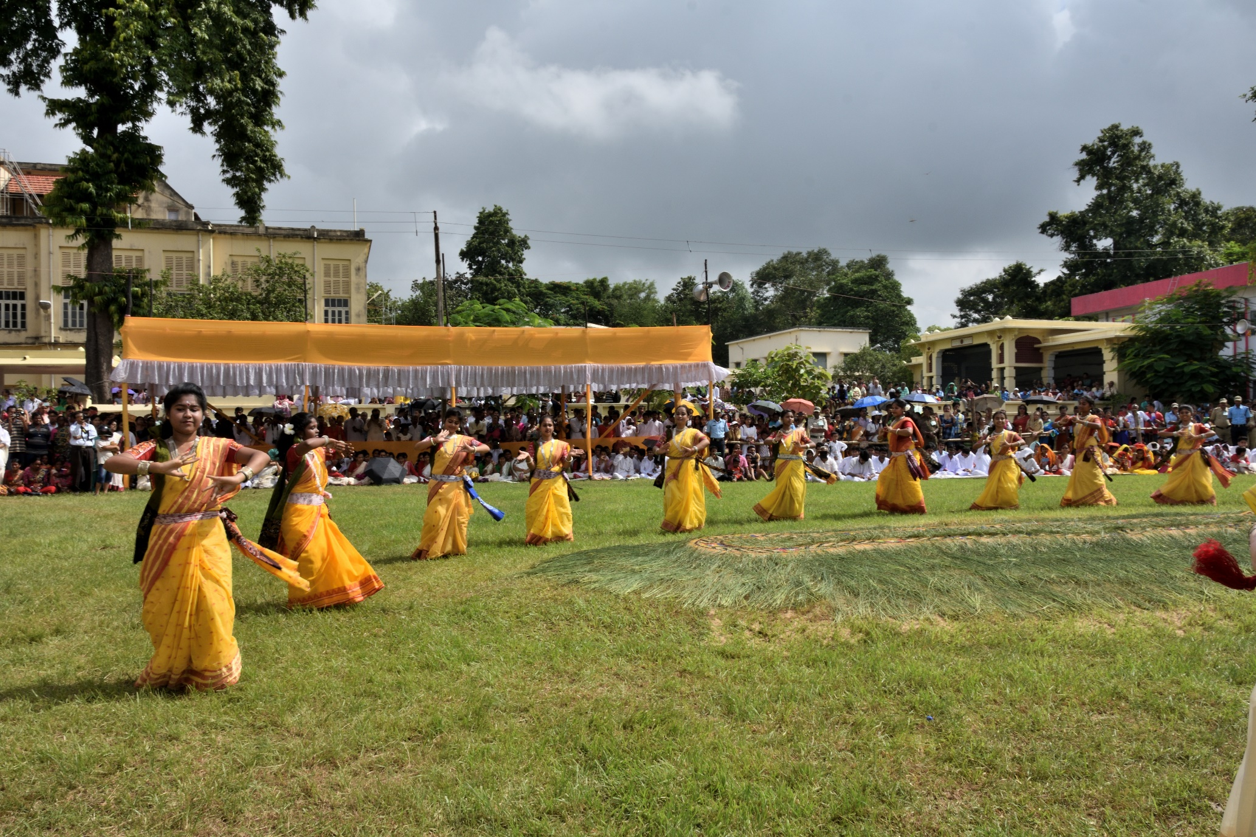

Slide 33
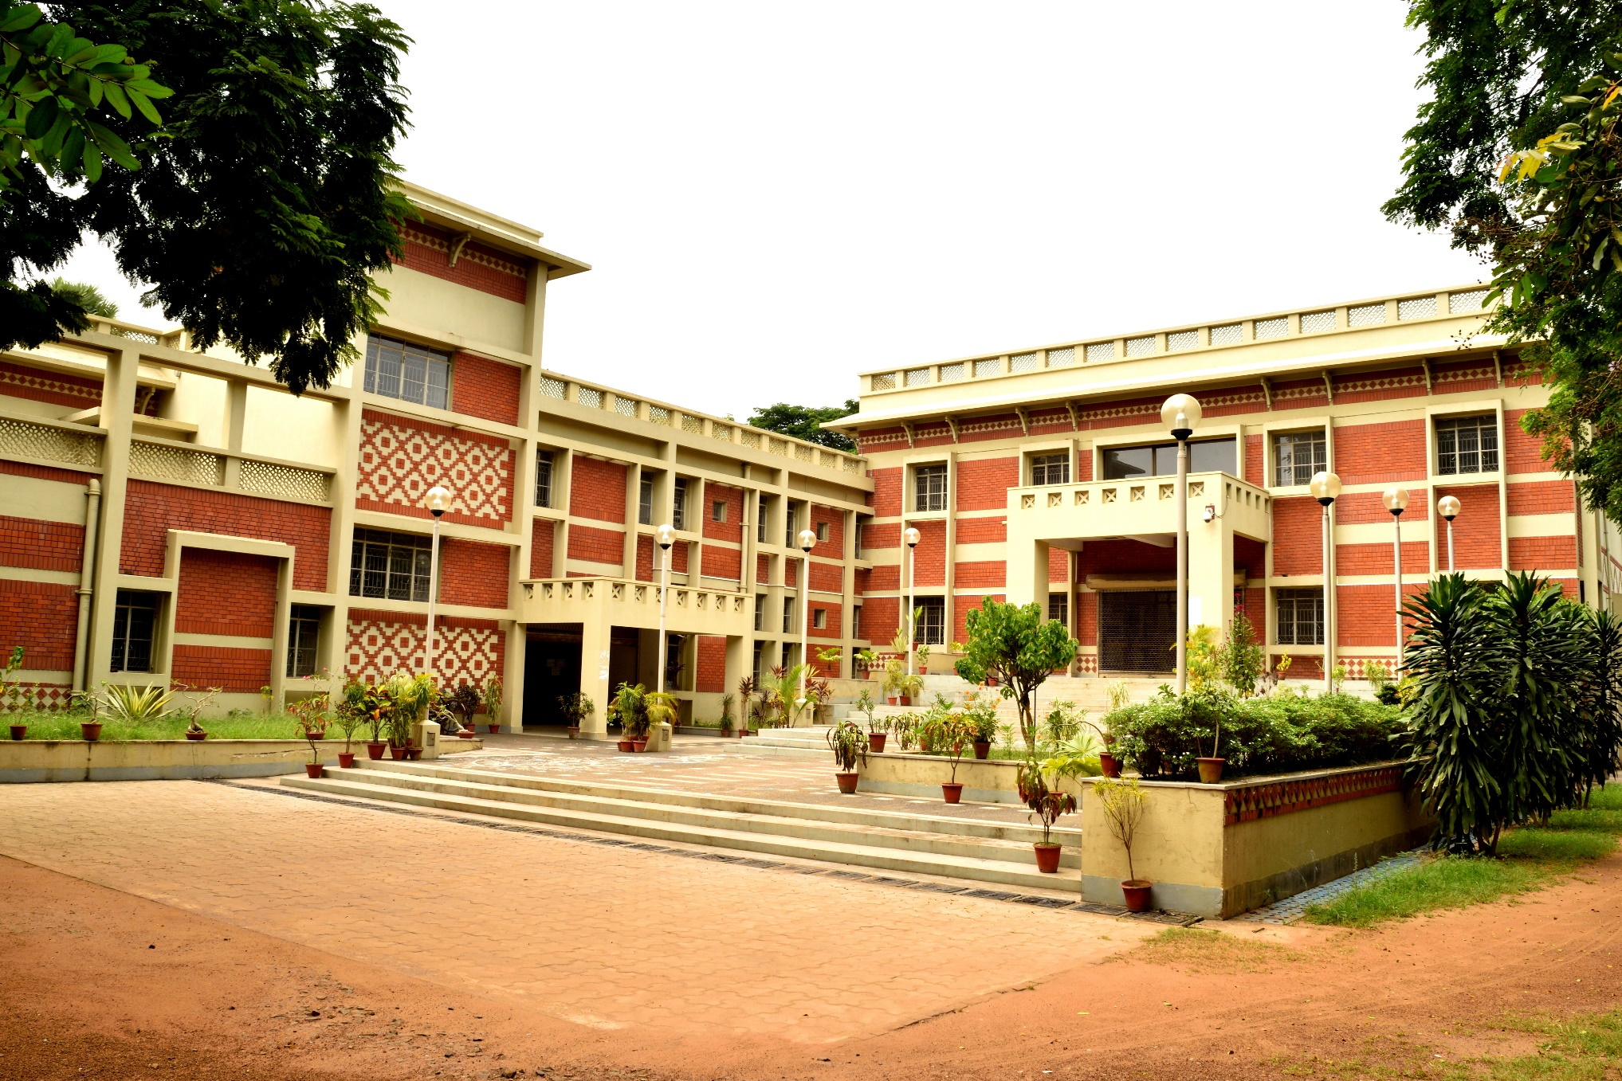

Slide 34
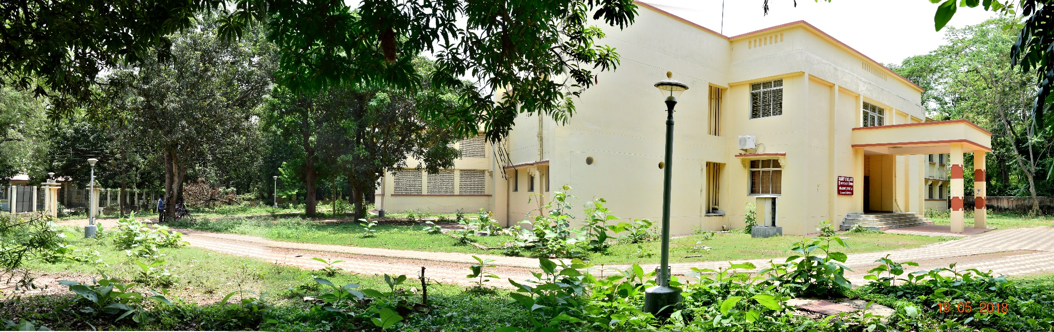

Slide 35
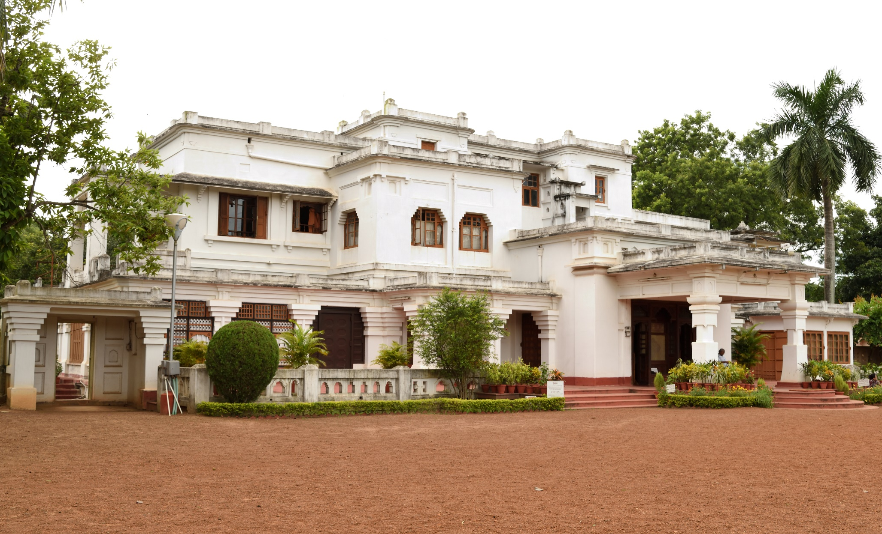

Slide 36
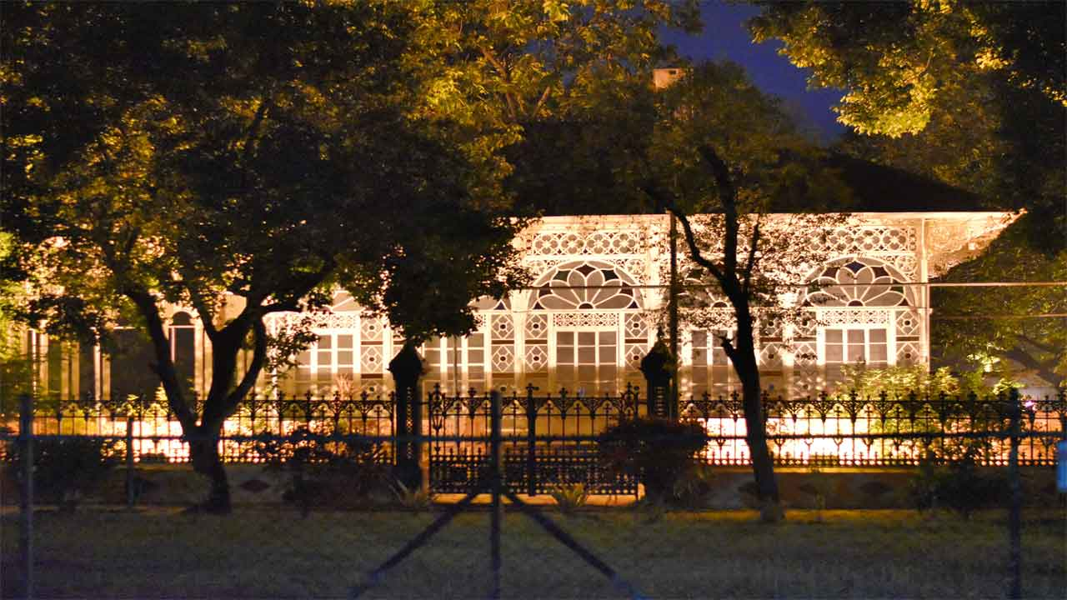

Slide 37
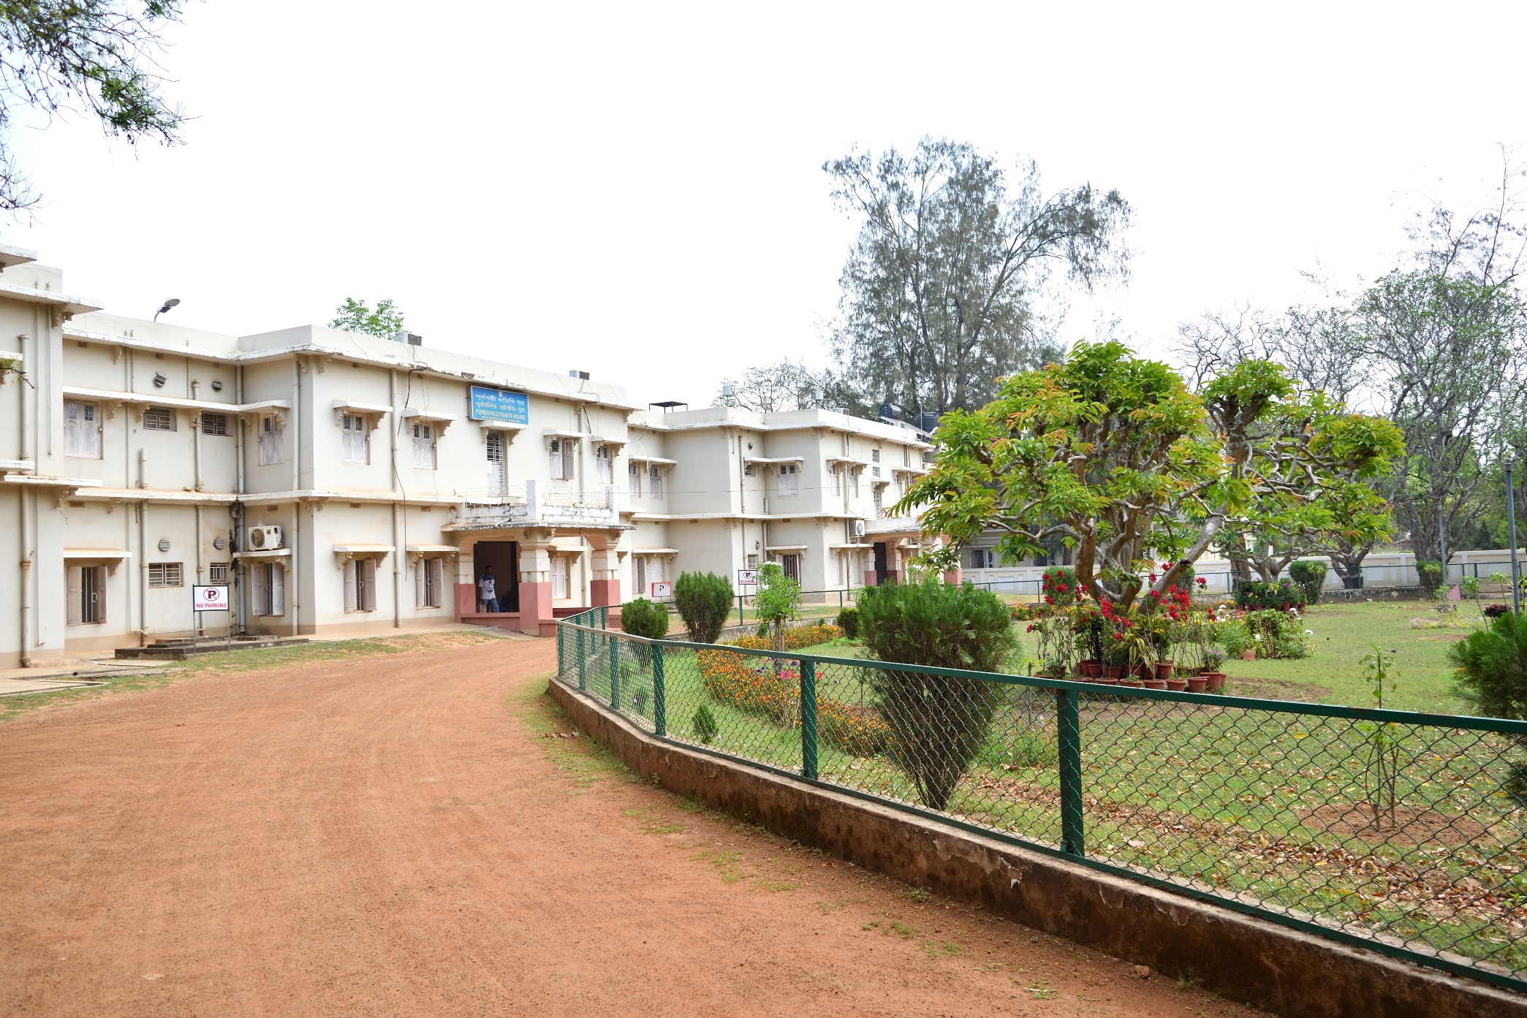

Slide 38
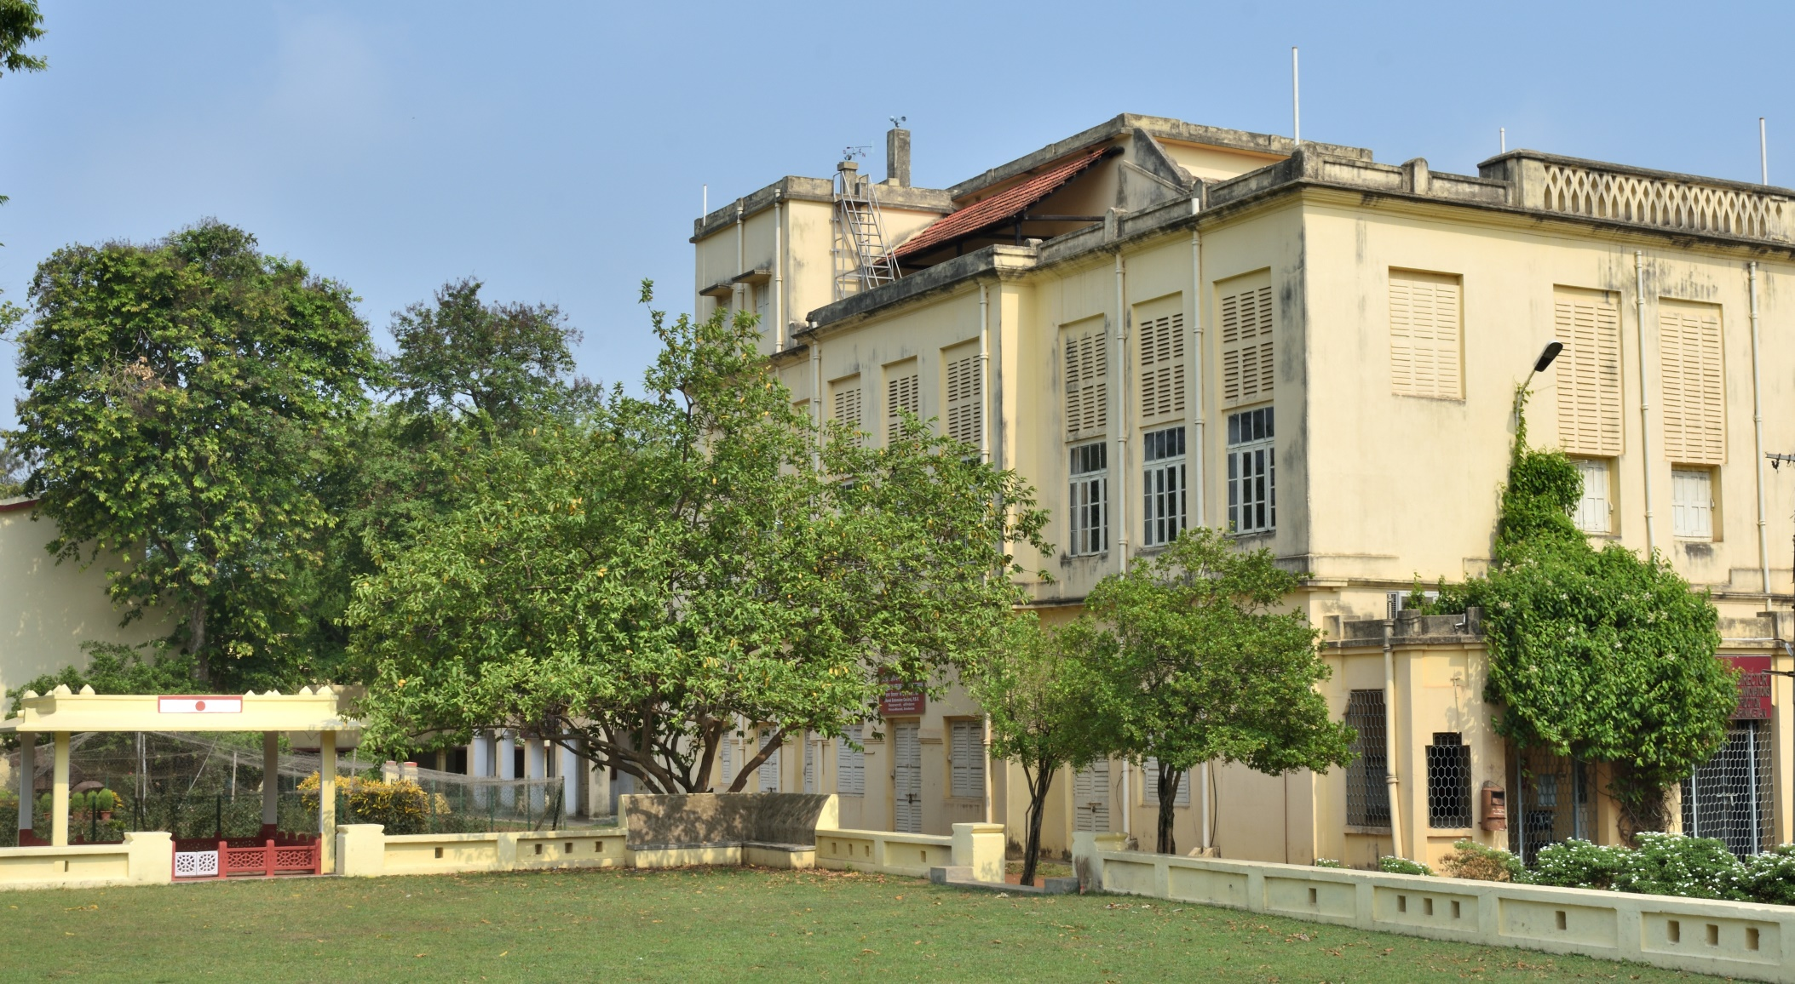

Slide 39
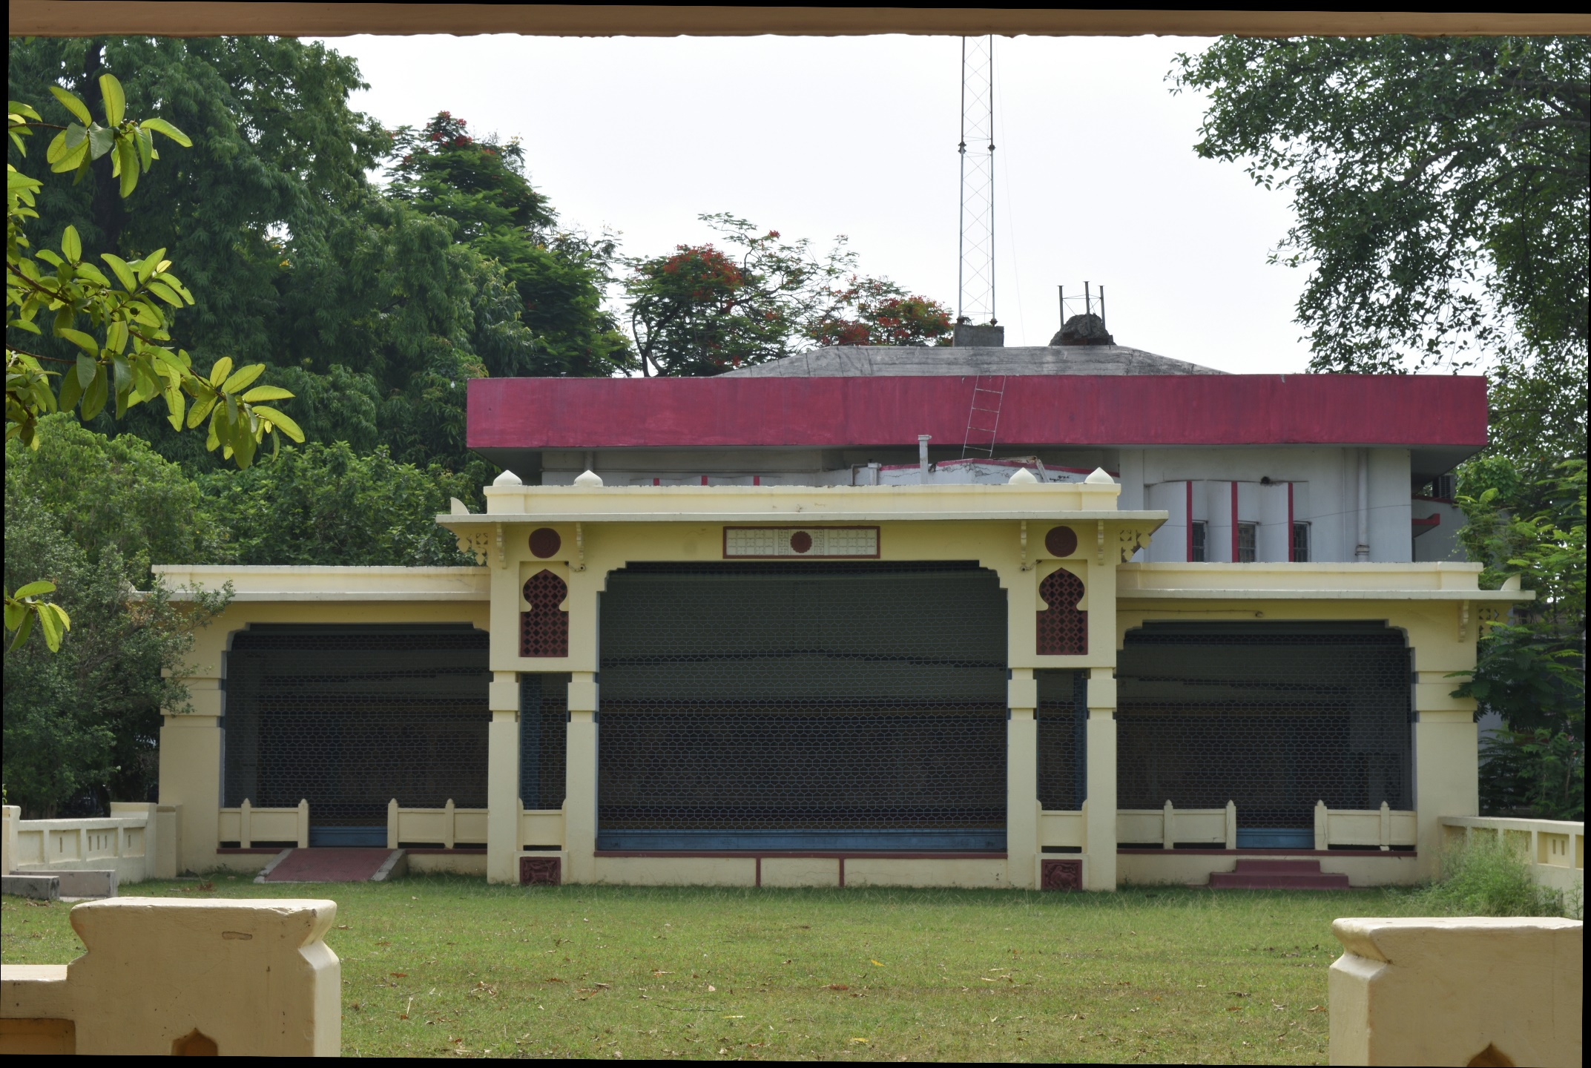

Slide 40
Change in infrastructure and attitude of employees made the organisation viable
All the employees are covered under social security like PF, Gratuity, Family pension, med claim, GSLI etc.
The management styles adopted are participatory in nature
Workers do not leave the organisation till the age of 62 years which is fixed retirement age
The Executive body is elected with professional without any honorarium. The employees (one-third) represent the executive body but can not hold the positions like Chairman, Secretary etc.

Slide 41
Fair Trade for Social Entrepreneurs
Sustainable business depends on the fairness to all concerned –the Planet, People and the Profit.
Fair trade following the principles of ethical business and membership of IFTO, WFTO
Options for the incubators could be Govt. schemes, social entrepreneurship, CSR program attachment/association for Consultancies in small business development to govt. and non-govt. bodies and individuals .

Slide 42
Thanks for your patience and attention
Please feel free to ask Questions / clarifications or comments if any …

