Slide 1
A sociocultural approach to labour market integration
Notes:
10.30
Peter:
Welcome to our workshop!
We both work at the Lucerne school of social work in the same institute, the institute for sociocultural development.
Our institut is involved mainly in question of community development or animation socio-culturelle in Switzerland, in neighbourhood development projects.
We also are responsible for the bachelor degree in community development or animation socio-culturelle. Many of our students work in youth work, cultural centers or community centers in Switzerland.
So how come, we speak about labour market integration in a country such as Albania?
Roma decade (2005 – 2015). European Comission → aim to “close the gaps between Roma and the rest of society,”
Swiss development cooperation took part and wanted Swisscontact (swiss Foundation for development cooperation) to develop a project for inclusion of marginalized groups in vocational education and training.
Development of a concept and implementation of the coaching for employment and entrepreneurship project since 2010

Slide 2
Workshop Content
The Albanian Context
The Coaching for Employment and Entrepreneurship Project
Coaching Cycles and Training of Coaches
Socio-cultural Aspects of the project
Group Interventions as a core element
Participatory project development and implementation
Empowerment
Notes:
Peter:
In this workshop we would like to share our project experience with you and focus especially on group interventions since this is a core element of our concept.
First we would like to give you some background information on recent developments in Albania, since they are crucial for our project and are the context of our project and conceptual thoughts.
This also includes some informations about the situation of the roma communities in Albania, being one of the most marginalized groups in the country.
After this context information we would like to speak about the project itself, to give you an idea what we are actually doing. After that we would like to focus the groups interventions made, which we see as a core element and that diferenciate our approach from other coaching approaches in the field of labour market inclusion.
After our presentation we would like you to exchange your experiences with learning groups and the potential and challenges they offer for the fields of social work.
We will finish the workshop addressing some key findings from our experience concerning the sustainability of development projects.
→ Who of the participants would summarize the workshop for the plenary?

Slide 3
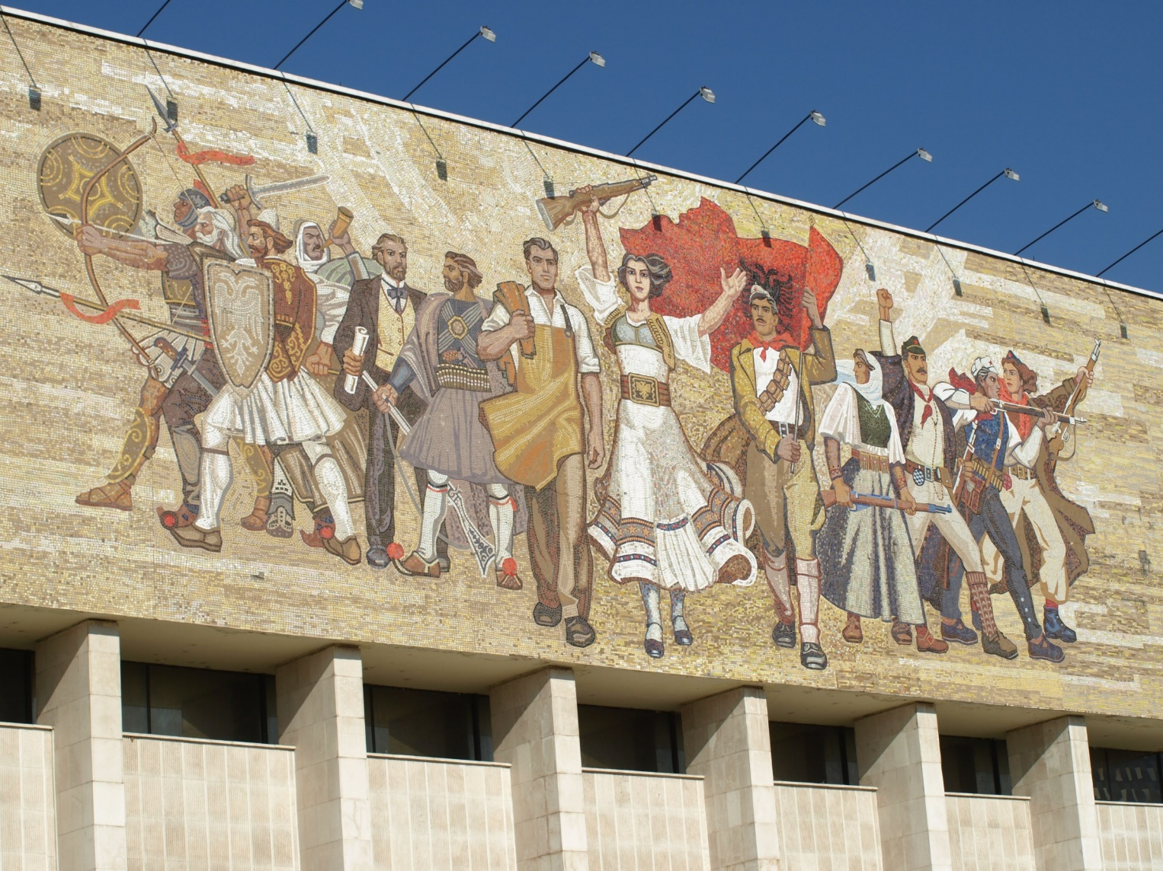
Albanian Kontext: political Transition
Notes:
Peter:
One of the strictest and most totalitarian communist regimes in europe
The regime tried to control all areas of life, observation, controll and distruction of civil society.
Propaganda and restrictions to individual freedom and travelling.
1961 Bruch mit Sowjetunion (Chruschtschow) anschliessend Büdnis mit China, Since the end of the 70ies, isolation, stagnation, poverty and hunger decay of state institutions.

Slide 4
Political transition
Typical elements of eastern european transition (cp. Egger 2006)
Abrupt change end of the 80s and beginning of the 90s
little political opposition
Only a few civil society organisations
Top-down set-up of democratic structures and institutions
Staff consistency in public organisations → existing insider relationships
→ little political changes
Notes:
Bernard

Slide 5
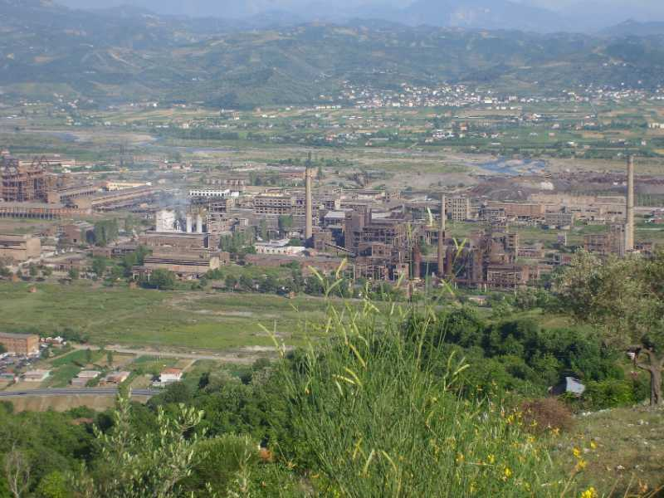
economical transition
Notes:
Bernard
- Complete reconstruction of the economic system
From centrally planned economy to a market economy
Products not sellable anymore
Breakdown of entire economic branches (see picture)
(public) vocational Education does not match market requirements
High unemployment (currently 15%, youth unemployment 33% INSTAT, Labour Market, 2014, pg.8)
Many familial and informal businesses
Most Students prefer University, even though ist not the best choice for the labour market

Slide 6
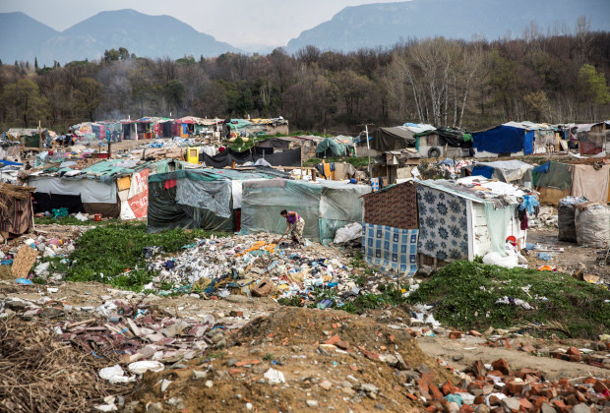
social transition, marginalized groups
Notes:
Peter:
Approx. 95’000 – 150’000 (3-4% of Albanian population)
High level of poverty (Unicef 2007):
78% of the Roma live with less then € 100 / months.
Estimated unemployment is 75% (EU-Average: 65%).
- Roma face discrimination on the labour market.
Education:
Only 13% visit kindergarden. 40% are illiterate (Osmanaj, 2013). 45% of the 15-24 year old are illiterate (unicef, 2007)
One of two Roma children does not finish compulsory school.
(Salamun 2009).
→ The discrimination of Roma communities has significantly aggraviated since the fall of the communist regime

Slide 7
Roma in Albania
Approx. 95’000 – 150’000 (3-4% of Albanian population)
High level of poverty (Unicef 2007):
78% of the Roma live with less then € 100 / months.
Estimated unemployment is 75% (EU-Average: 65%).
- Roma face discrimination on the labour market.
Education:
Only 13% visit kindergarden. 40% are illiterate (Osmanaj, 2013). 45% of the 15-24 year old are illiterate (unicef, 2007)
One of two Roma children does not finish compulsory school.
(Salamun 2009).
→ The discrimination of Roma communities has significantly aggraviated since the fall of the communist regime
Notes:
Peter:
In the 2011 Census, only 0.3 % of the population stated to be Roma!
Roma fear discrimination. Many live in extreme poverty.
Roma Kinder werden von LehrerInnen und SchülerInnen diskriminiert
Die Schulen sind weit entfernt → Kidnappinggefahr
Nur 13% besuchen den Kindergarten.
Ohne Schulabschluss verfügen Roma-Jugendliche nicht über die notwendigen Voraussetzungen, um Berufsausbildungen zu besuchen.
Romas finden sich nicht in der Verwaltung, der Armee oder anderen angesehenen Berufen. Die Arbeitslosigkeit unter den Roma beträgt ca. 80-90%.
Other minorities are also discriminated e.g. Egyptians, greek, migrants…
Roma is often used as a general term for many ethnic groups (ashkali, former also Egyptians etc.)

Slide 8
2. The Coaching for Employment Project
Main Goal:
Support the access of vulnerable and marginalized groups to vocational education and the labour market (Employability)
Sub-goals:
Support participants in their self-confidence and identity formation
Participants develop social, methodological professional and self-competencens, that increase their chances to enter the labour market, education programs or develop own business ideas.
Participants know the requirements for a professional career and are able to realistically evaluate their own situation and opportunities.
Notes:
- Warum sind wir als Hochschule in Albanien?

Slide 9
Training of Coaches and Coaching Cycles
A Training for Coaches from partner organisations
40 days of training over 15 months
Coaches implement Coaching Cycles with groups of 15 young people from vulnerable/marginalized groups, age 18-35
Coaching Cylces last 12 months

Slide 10
The Coaching Cycle Process
Coaching Cycle
Employment /Self employment
Business plan Development
Working & Learning in Groups
Exploring World of Labour
Short Internships
Individual Development Plan
Vocational Training
Getting into Business
Long Internships
Community Activities

Slide 11
The Coaching for Employment and Entrepreneurship Project
2010-2014
Development of a Coaching Approach and Training of local NGO staff to support young people from marginalized groups in school-work transition and access to Vocational Education and Training.
2015-2016
Training of National Employment Services (NES) staff to support young people from vulnerable groups in school-work transition and access to Vocational Education and Training.
2017 – 2020
Development of the project towards more flexibility in Coaching and widen the project scope to the republic of Kosovo.
Notes:
10.55 Bernard:
Swisscontact Project in Collaboration with Lucerne University – School of social work since 2010
Financed by Swisscontact, Medicor Foundation and SDC
Facts and Figures:
75 Coaches Trained or in Training in Albania and Kosovo
Coaches worked with over 1000 Participants
50-60% Of the Participants are Employed or Self-Employed after the Programm

Slide 12
Project outcomes 2010 - 2019
approx. 100 Coaches trained from NGO and state institutions (Employment Services) in Albania and Kosovo
3000 Youth going through Coaching Cycles
Employment rate at the end of a coaching cycle 60%
10’000 (short) internships

Slide 13
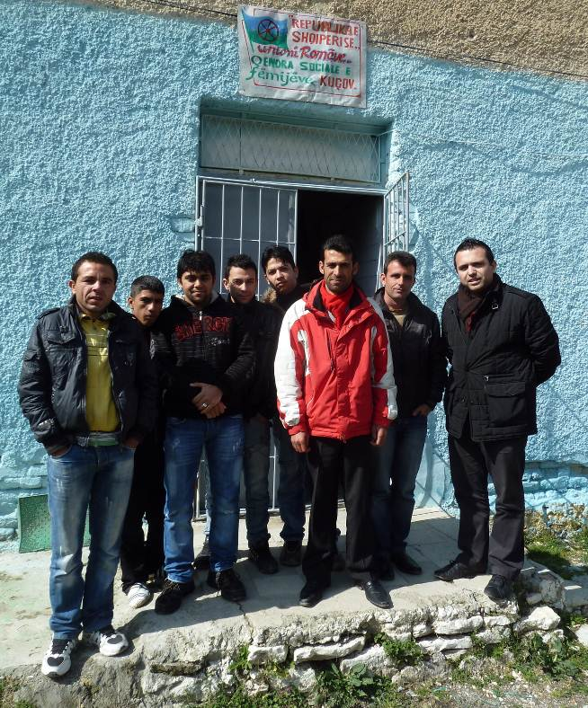
Socio-cultural apects of the project: Group Interventions as a core Element
The group as a learning environment – learning from and with others
The group as supportive environment for marginalized youth
Development of social and self-competences in a group
A group offers specific training opportunities (e.g. roleplays)
Integration starts in the group itself
Notes:
Peter:
The group work approach is one of the main differences in the C4EE project compared to other Coaching Projects.
In our project one of the main focus of the coaching was to create a supportive learning environment in the group.
We have experienced, that youth from marginalized groups face many dificulties in carrying out task we would think of being easy, such as going outside, move freely in the city, contact business owners and find the courage to ask questions to adults or people outside the community. This was especially important for the phase of exploring the world of labour.
Also for the development of social and self-competences the group plays an important role: teamwork, reliability, cordiality and respect are trained with other participants. The group can also observe oneanother and give critical feedback on certain behaviours. A group also offers specific training opportunities such as roleplays.

Slide 14
Socio-cultural apects of the project: Participatory Project Development and Implementation
Involvement of Organizations and Communities in the initial project design
Involving target group organizations and Coaches (Roma & Egiptians)
Training of Coaches: Space for joint reflection and project development
Involvement of participants in defining their interests, goals and activities during the Coaching Cycle

Slide 15
Socio-cultural apects of the project: Working with the community
Involvement of Organizations and Communities in the initial project design
Community Activities: Link the project to the community, involve community in project activities
Training of Coaches: Space for joint reflection and project development
Involvement of participants in defining their interests, goals and activities during the Coaching Cycle
Notes:
Peter:
The group work approach is one of the main differences in the C4EE project compared to other Coaching Projects.
In our project one of the main focus of the coaching was to create a supportive learning environment in the group.
We have experienced, that youth from marginalized groups face many dificulties in carrying out task we would think of being easy, such as going outside, move freely in the city, contact business owners and find the courage to ask questions to adults or people outside the community. This was especially important for the phase of exploring the world of labour.
Also for the development of social and self-competences the group plays an important role: teamwork, reliability, cordiality and respect are trained with other participants. The group can also observe oneanother and give critical feedback on certain behaviours. A group also offers specific training opportunities such as roleplays.

Slide 16
Socio-cultural Apects of the project: Empowerment
Participants explore their interests, motivations and the labour market situation in a group and individually
Participants develop a realistic image about their situation and opportunities
The Participants choose their goals and activities according to their interests
Reflect experiences of marginalization in a group
Find solutions and coping strategies together
Train how to deal with deceptions and discrimating situations in the group
Coaches facilitate direct contact between business owners and participants
Notes:
11.15 Peter:

